Slide 1
Progress Report
Hurricane Wind Speed Prediction Using Deep Learning and Machine Learning

Slide 2
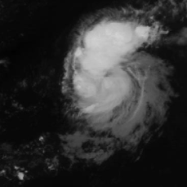
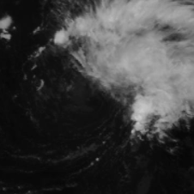
Project Summary
Tropical cyclones have become more destructive in the last decades due to increase in surface temperature as a result of global warming
Humanitarian response efforts hinge on accurate risk approximation models that depend on wind speed measurements
For several decades, forecasters have relied on visual pattern recognition of complex cloud features in visible and infrared imagery.
However, visual inspection is manual, subjective and often leads to inconsistent estimates.
This is the reason why we want to design and develop a system using Deep Learning and Machine Learning which predicts the hurricane’s speed using satellite images.

Slide 3
Milestones
October 19: Completing of preparation of images for baseline model and implementation and initial results of baseline model.
November 2: Hyperparameter Tuning results for baseline model. Completion of preparation of images for pre-trained models (converting single-band images to RGB images based on timestep).
November 16: Completion of pre-trained model training, hyperparameter tuning.
November 30: Feature Extraction using CNNs and Implementation of Machine Learning Models
December 14: Model evaluation and Performance Comparison. Completion of Final Report.

Slide 4
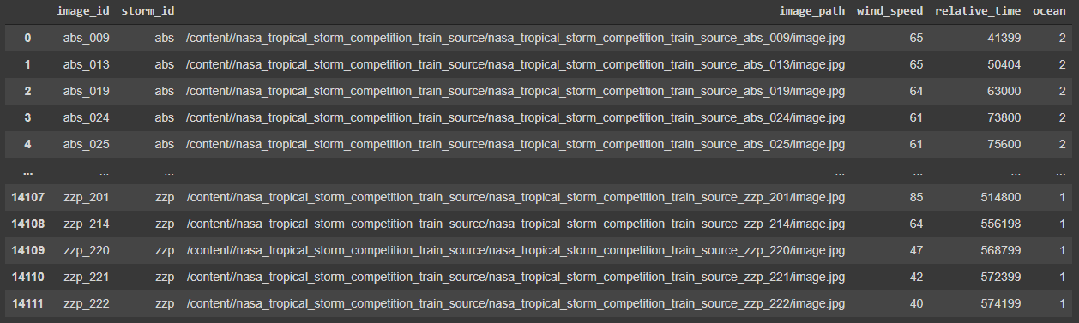
Updated Metadata

Slide 5
Custom Data Loader
Since our data was not in the required format, we had to create a custom data loader.
We created a dataframe which consists of image ID and image path pairs along with other available metadata.
Then we wrapped this dataframe in a class in-order to pass it to pytorch’s DataLoader module (along with actual images).
We normalized and cropped images.
Finally we split our data into training, testing and validation sets.

Slide 6
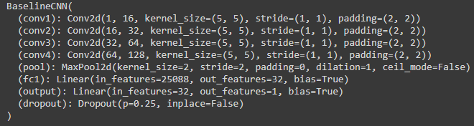
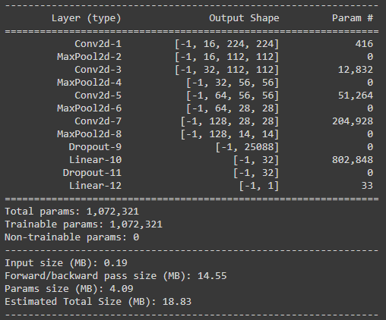
Baseline CNN
Our baseline model takes single band images X: Image, y: corresponding wind speed Loss Function: MSE Loss
Optimizer: Adam Learning Rate: 0.001 Batch Size: 256 Epochs: 50 Train size: 56K+
Validation size: 15K
Regularization: Dropout with p=0.25

Slide 7
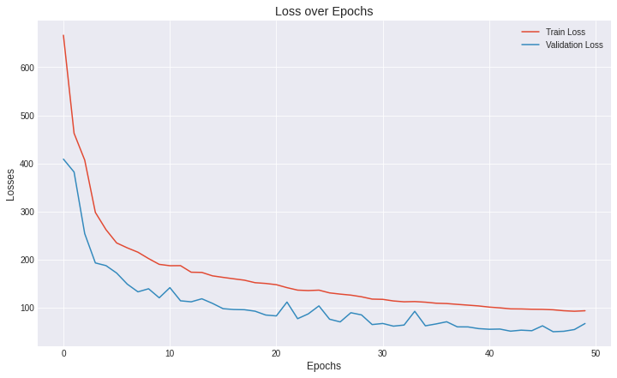
Model Performance
Training Time: 4.5 hrs
GPU: Tesla P100
Train RMSE: 9.78
Validation RMSE: 7.07
Test RMSE: 8.68
Competition benchmark: 12.69 (VGG16)

Slide 8
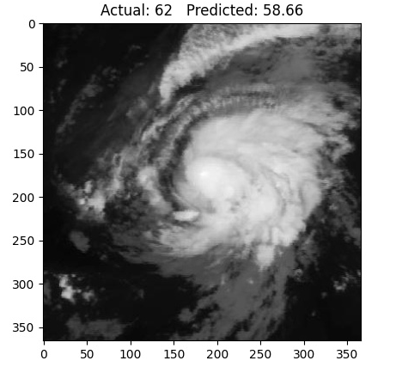
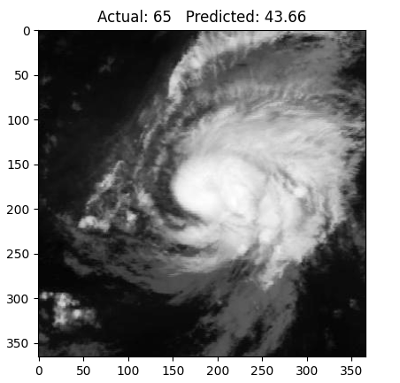
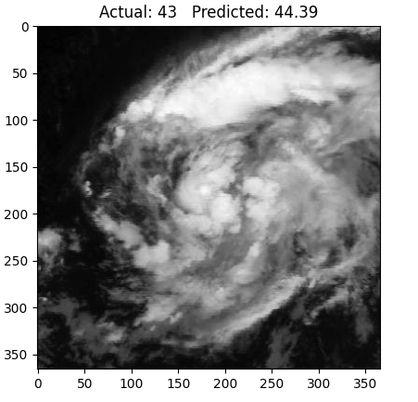
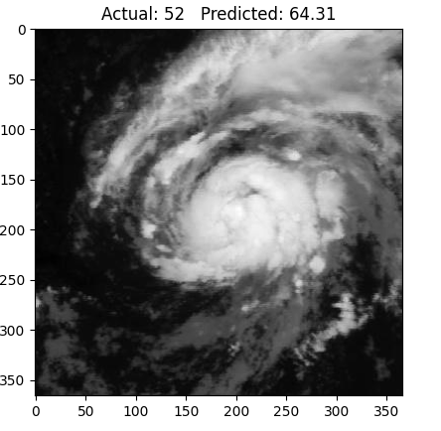
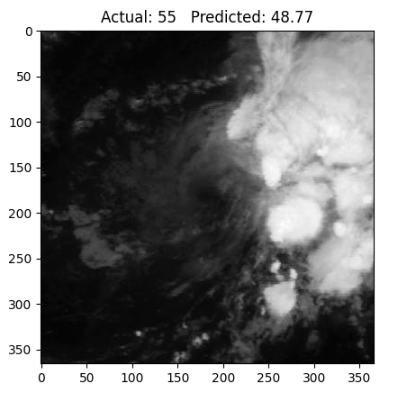
Sample Outputs

Slide 9
Questions and Suggestions?

